Slide 1
Generic object recognition - classification (Szeliski 14.1, Solem 8.1~3 (python book), and Grauman&Liebe 7,8,9.1,11.1)
Michael S. Ryoo

Slide 2
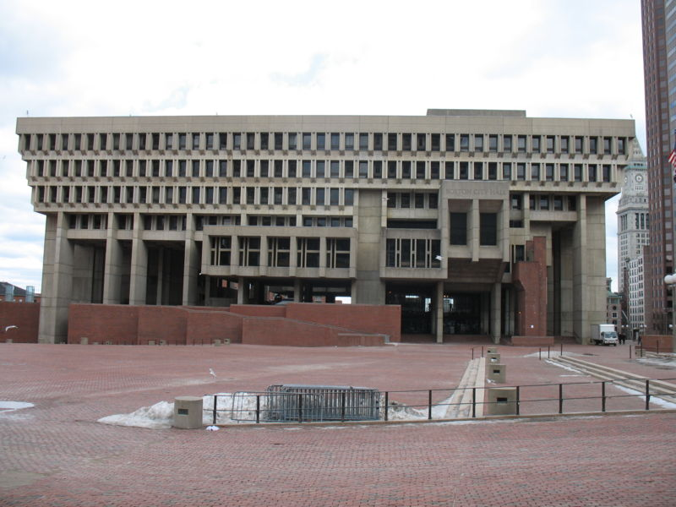
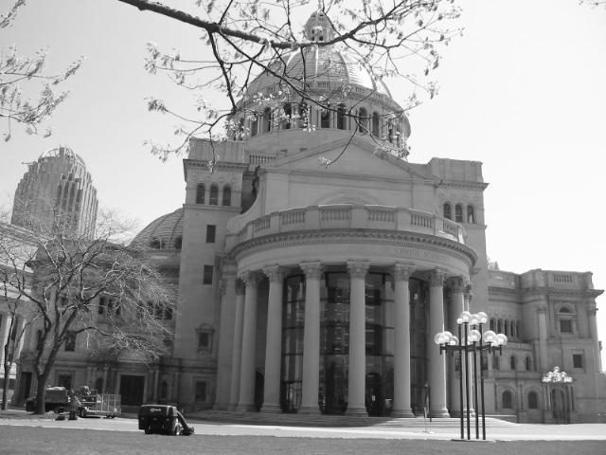
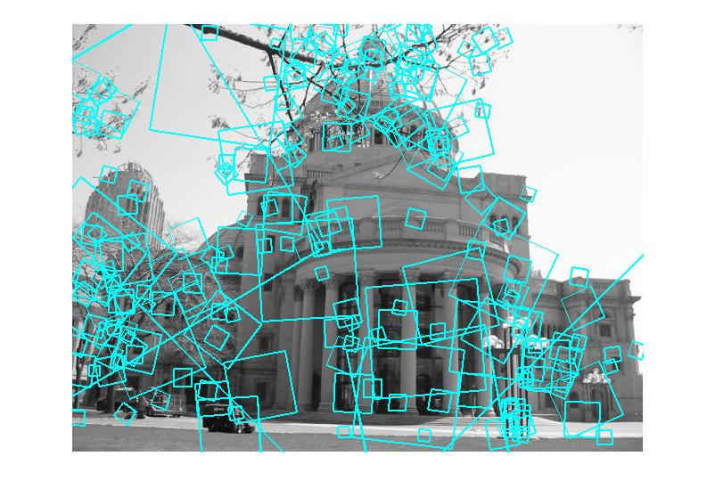
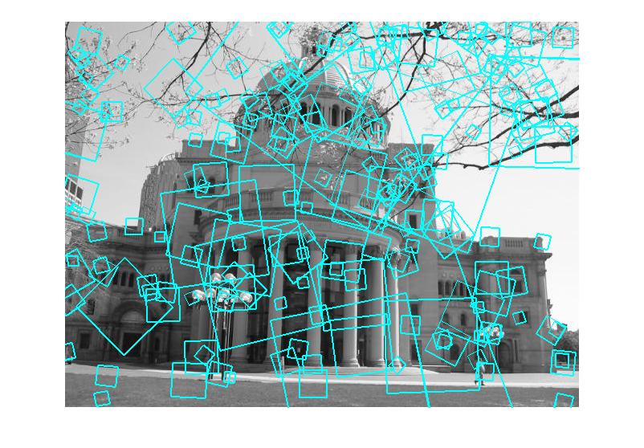
Indexing local features
…
Kristen Grauman

Slide 3
Visual words
Map high-dimensional descriptors to tokens/words by quantizing the feature space
Quantize via clustering, let cluster centers be the prototype “words”
Word #2
Determine which word to assign to each new image region by finding the closest cluster center.
Descriptor’s feature space
Kristen Grauman

Slide 4
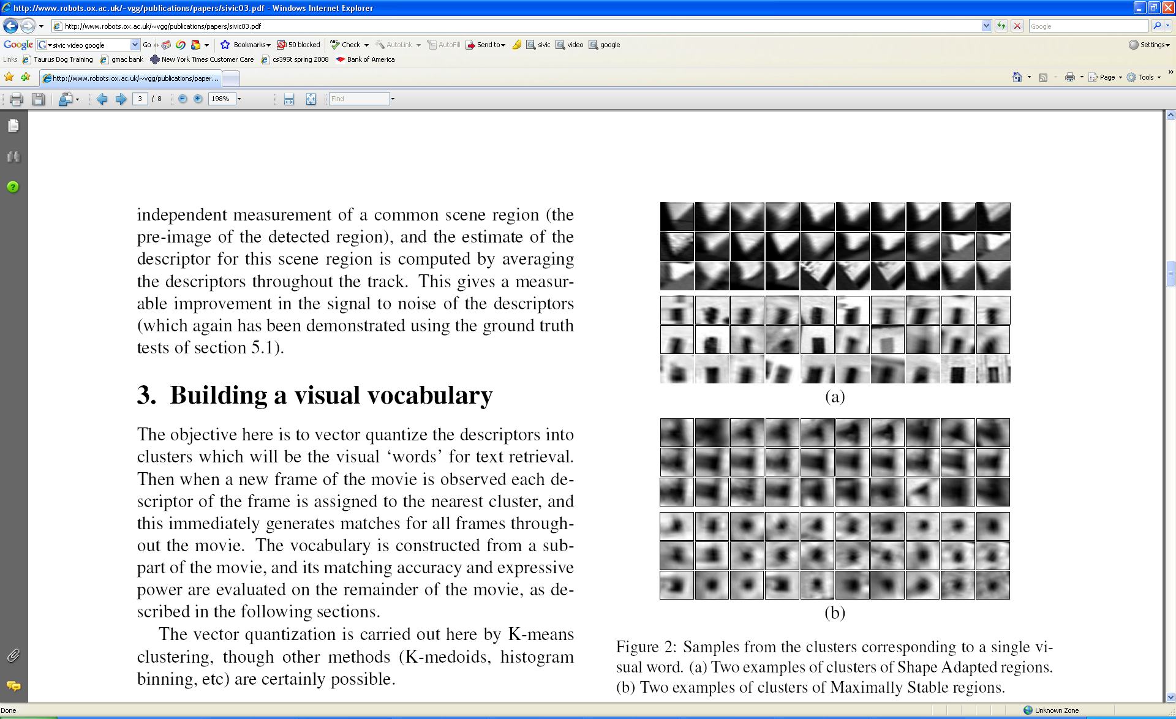
Visual words
Example: each group of patches belongs to the same visual word
Figure from Sivic & Zisserman, ICCV 2003
Kristen Grauman

Slide 5
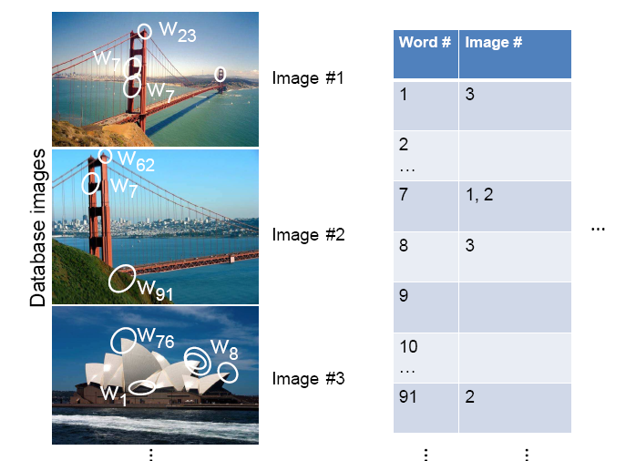
Inverted file index
Database images are loaded into the index mapping words to image numbers
Kristen Grauman

Slide 6
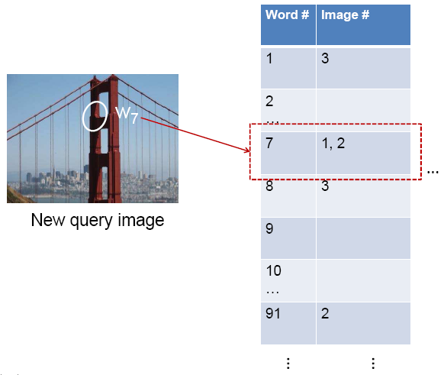
Inverted file index
When will this give us a significant gain in efficiency?
New query image is mapped to indices of database images that share a word.
Kristen Grauman

Slide 7
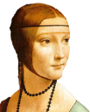
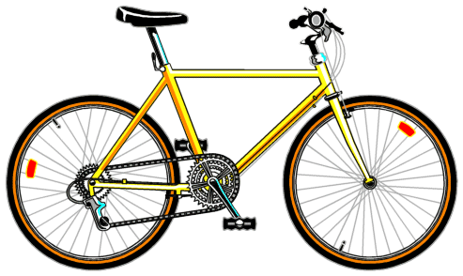
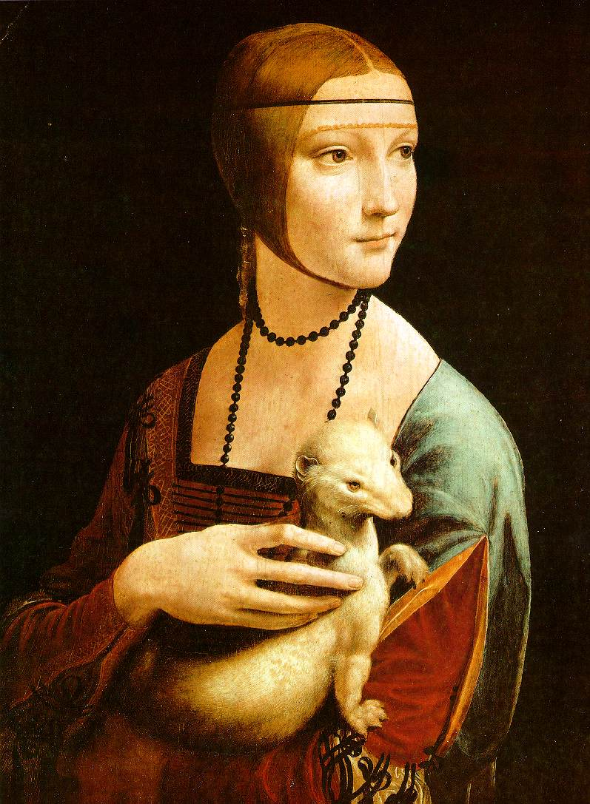
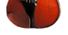

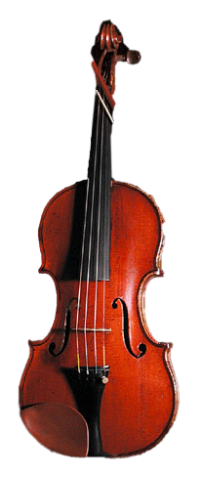
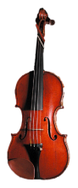

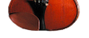

Bags of visual words
Summarize entire image based on its distribution (histogram) of word occurrences.
Analogous to bag of words representation commonly used for documents.
Notes:
7

Slide 8
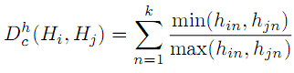
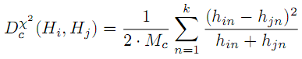

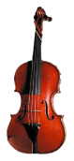



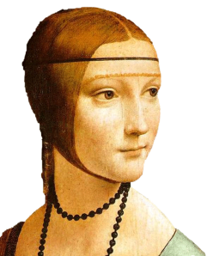
Comparing bags of words
Multiple different types of ‘kernels’ can be used to measure the ‘distance’ between histograms --nearest neighbor search for similar images.
[1 8 1 4]
[5 1 1 0]
for vocabulary of k words
Notes:
(possibly weighted)
Cosine similarity

Slide 9
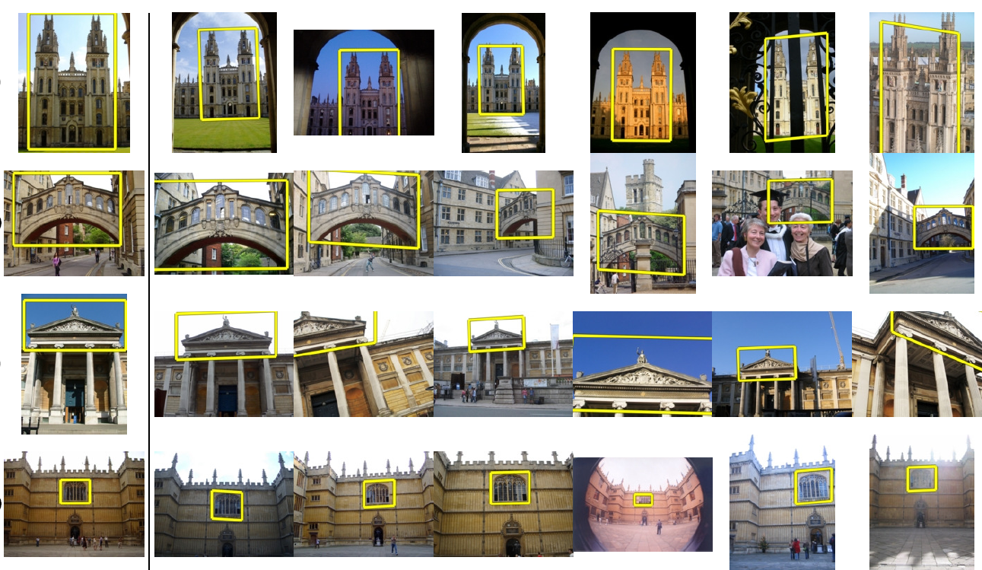
Application: Large-Scale Retrieval
Query
Results from 5k Flickr images (demo available for 100k set)
[Philbin CVPR’07]

Slide 10
Spatial Verification: two basic strategies
RANSAC
Typically sort by BoW similarity as initial filter
Verify by checking support (inliers) for possible transformations
e.g., “success” if find a transformation with > N inlier correspondences
Generalized Hough Transform
Let each matched feature cast a vote on location, scale, orientation of the model object
Verify parameters with enough votes
Kristen Grauman

Slide 11
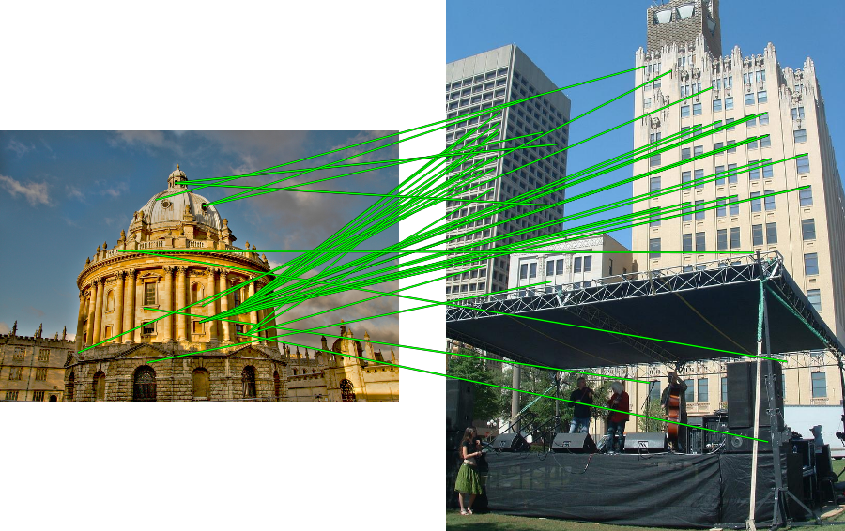
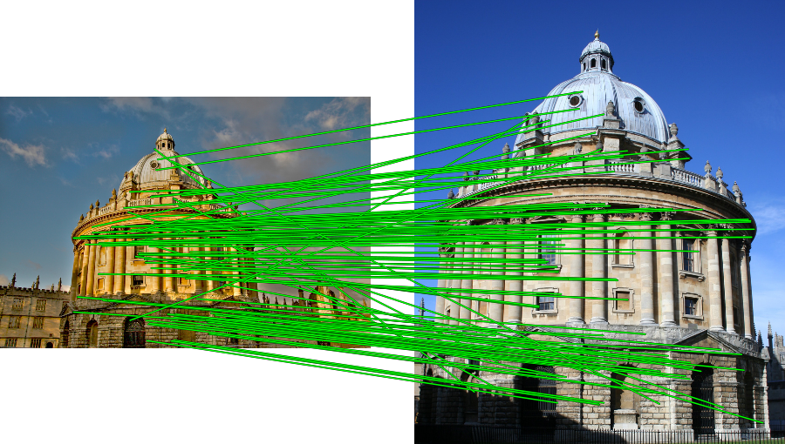
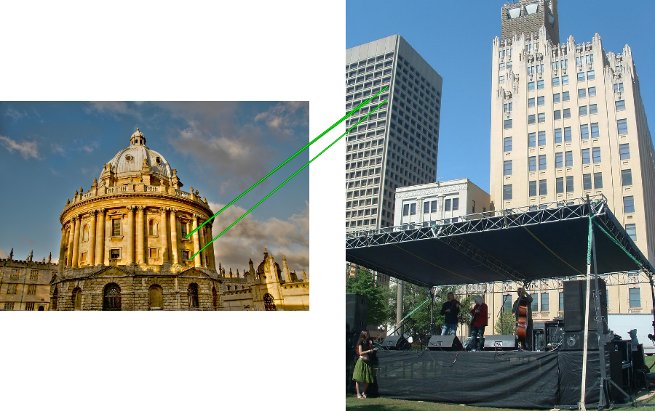
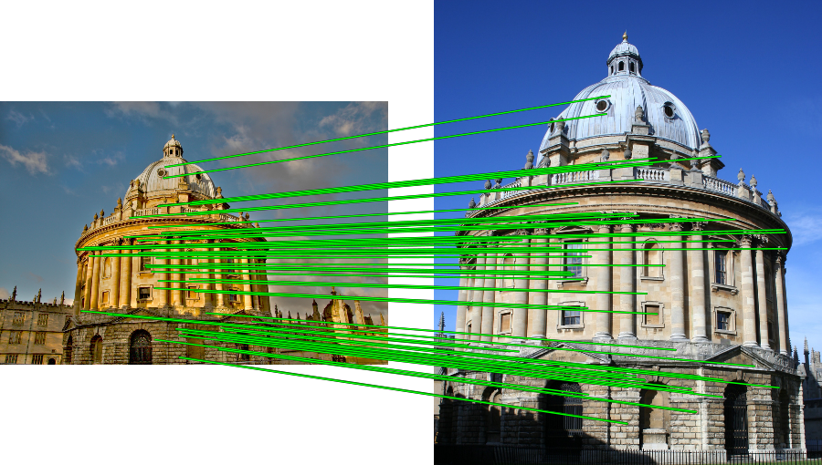
RANSAC verification

Slide 12
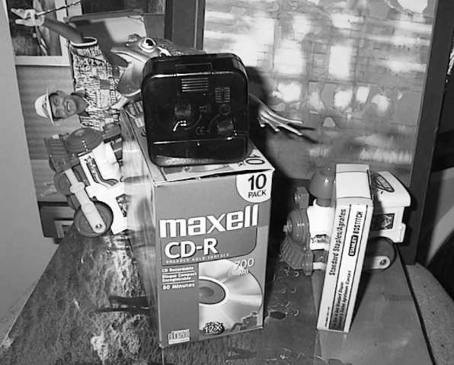
Voting: Generalized Hough Transform
If we use scale, rotation, and translation invariant local features, then each feature match gives an alignment hypothesis (for scale, translation, and orientation of model in image).
Model
Novel image
Adapted from Lana Lazebnik

Slide 13
Voting: Generalized Hough Transform
A hypothesis generated by a single match may be unreliable,
So let each match vote for a hypothesis in Hough space
Model
Novel image

Slide 14
Summary
Matching local invariant features
Useful to find objects and scenes
Bag of words representation: quantize feature space to make discrete set of visual words
Summarize image by distribution of words
Index individual words
Inverted index: pre-compute index to enable faster search at query time
Recognition of instances via alignment: matching local features followed by spatial verification
Robust fitting : RANSAC, GHT
Kristen Grauman

Slide 15

What we did so far
Image data
Feature space
Representation
Feature extraction
Matching
n-D data (e.g., n = 320*240)
k-D vector (e.g., 1000)

Slide 16
Conventional classification framework
Image data
Semantic labels
Representation
Feature extraction
Human 0.9 Not-human 0.1
Classifier
n-D data (e.g., n = 320*240)
s labels (e.g., s = 2)
k-D vector (e.g., 1000)

Slide 17
Today
Generic object recognition

Slide 18
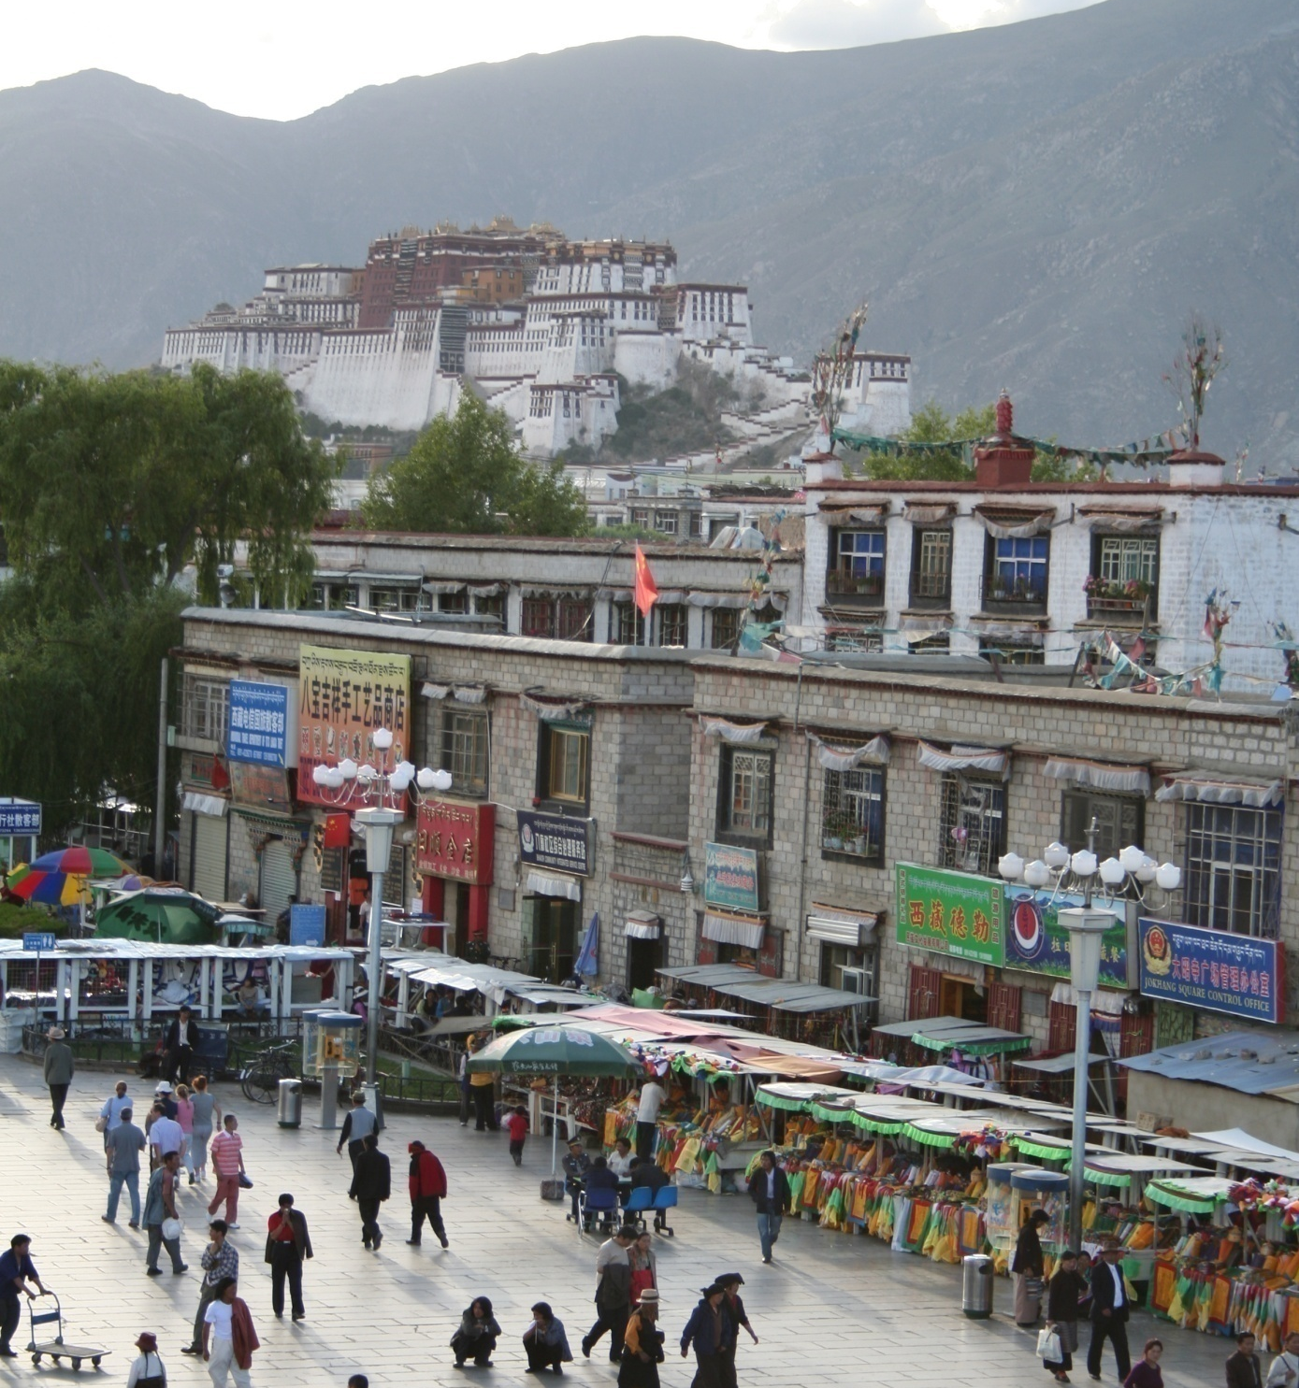
What does recognition involve?
Source: Fei-Fei Li, Rob Fergus, Antonio Torralba.

Slide 19
Verification: is that a lamp?
Source: Fei-Fei Li, Rob Fergus, Antonio Torralba.

Slide 20
Detection: are there people?
Source: Fei-Fei Li, Rob Fergus, Antonio Torralba.

Slide 21
Identification: is that Potala Palace?
Source: Fei-Fei Li, Rob Fergus, Antonio Torralba.

Slide 22
Object categorization
mountain
tree
building
banner
street lamp
vendor
people
Source: Fei-Fei Li, Rob Fergus, Antonio Torralba.

Slide 23
Scene and context categorization
outdoor
city
…
Source: Fei-Fei Li, Rob Fergus, Antonio Torralba.

Slide 24
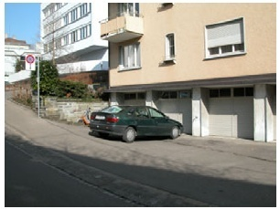
Instance-level recognition problem
John’s car

Slide 25
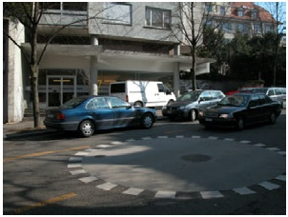
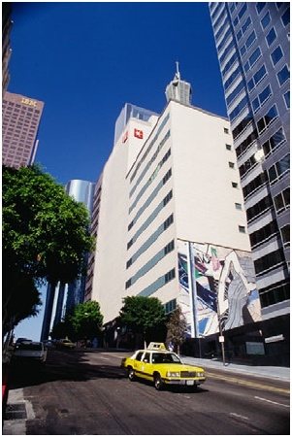
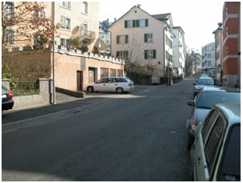
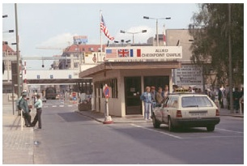
Generic categorization problem

Slide 26
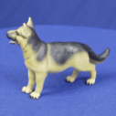
Object Categorization
“Fido”
German shepherd
dog
animal
living being
K. Grauman, B. Leibe
Task Description
“Given a small number of training images of a category, recognize a-priori unknown instances of that category and assign the correct category label.”
Which categories are feasible visually?

Slide 27
Visual Object Categories
Basic Level Categories in human categorization [Rosch 76, Lakoff 87]
The highest level at which category members have similar perceived shape
The highest level at which a single mental image reflects the entire category
The level at which human subjects are usually fastest at identifying category members
The first level named and understood by children
The highest level at which a person uses similar motor actions for interaction with category members
K. Grauman, B. Leibe

Slide 28
Visual Object Categories
…
animal
Abstract levels
…
…
quadruped
…
Basic level
dog
cat
cow
German shepherd
Doberman
Individual level
…
“Fido”
…
K. Grauman, B. Leibe
Basic-level categories in humans seem to be defined predominantly visually.
There is evidence that humans (usually) start with basic-level categorization before doing identification.

Slide 29
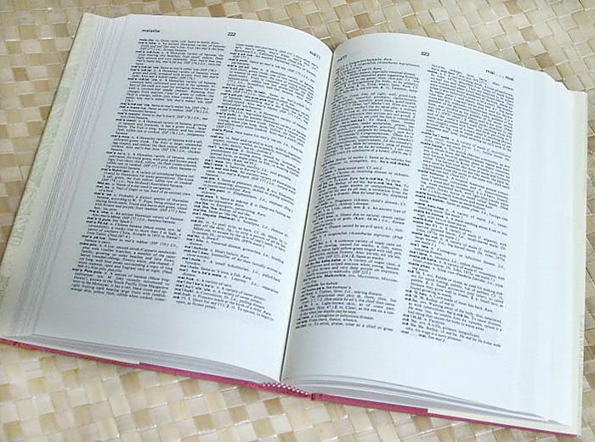

How many object categories are there?
~10,000 to 30,000
Biederman 1987
Source: Fei-Fei Li, Rob Fergus, Antonio Torralba.
Notes:
29

Slide 30
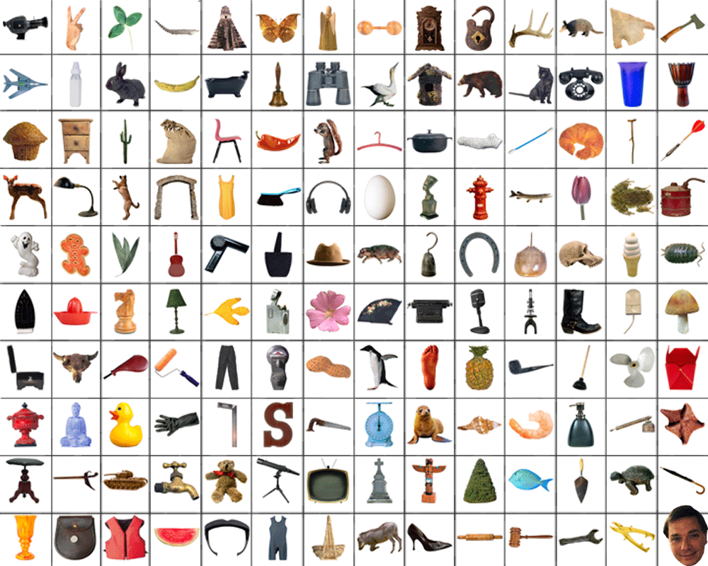
~10,000 to 30,000
Notes:
30

Slide 31
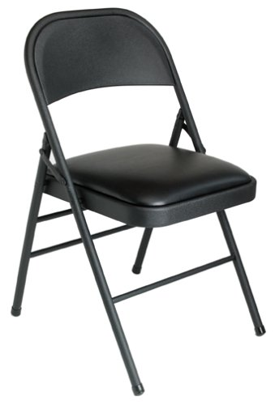
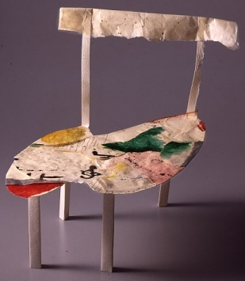
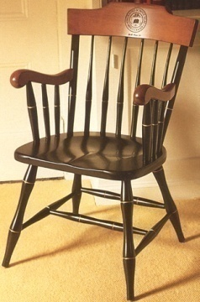
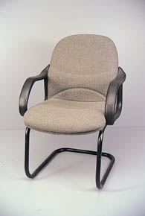
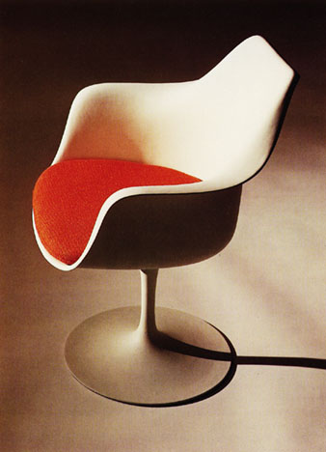
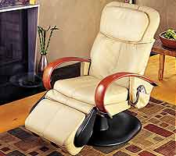
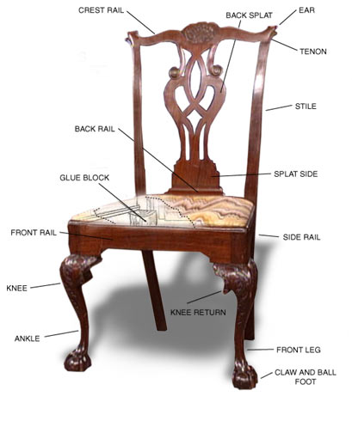
Other Types of Categories
K. Grauman, B. Leibe
Functional Categories
e.g. chairs = “something you can sit on”

Slide 32

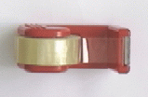
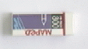

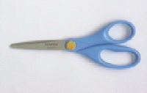
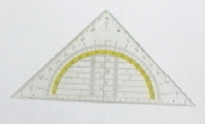
Other Types of Categories
K. Grauman, B. Leibe
Ad-hoc categories
e.g. “something you can find in an office environment”

Slide 33
Why recognition?
Recognition a fundamental part of perception
e.g., robots, autonomous agents
Organize and give access to visual content
Connect to information
Detect trends and themes
Notes:
33

Slide 34
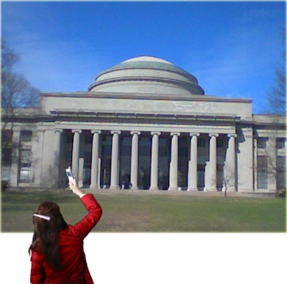
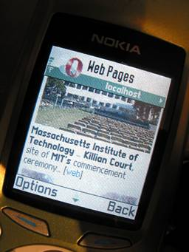
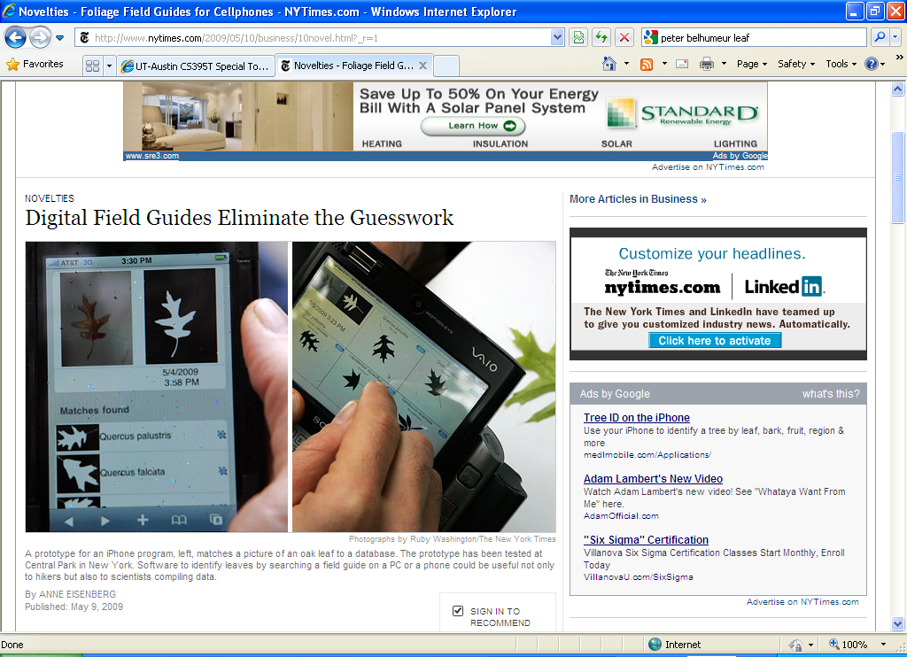


Posing visual queries
Yeh et al., MIT
Belhumeur et al.
Kooaba, Bay & Quack et al.

Slide 35
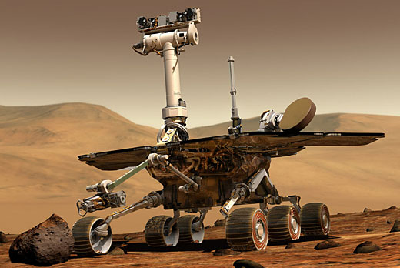
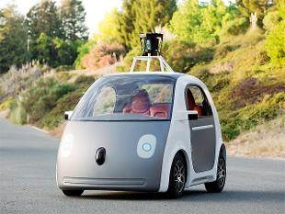
Autonomous agents able to detect objects

Slide 36

Finding visually similar objects
Notes:
36

Slide 37
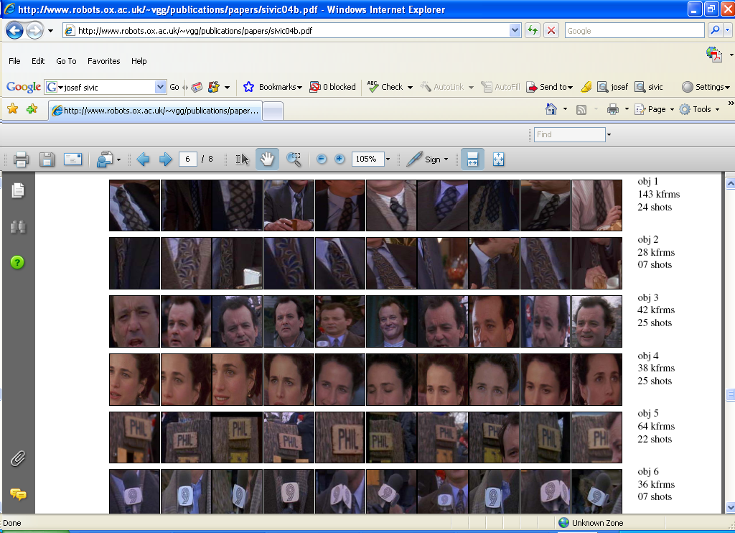


Discovering visual patterns
Objects
Sivic & Zisserman
Lee & Grauman
Categories
Actions
Wang et al.
Kristen Grauman

Slide 38


Auto-annotation
Gammeter et al.
T. Berg et al.
Kristen Grauman

Slide 39







Challenges: robustness
Illumination
Object pose
Clutter
Occlusions
Intra-class appearance
Viewpoint
Kristen Grauman

Slide 40
Challenges: robustness
Realistic scenes are crowded, cluttered, have overlapping objects.

Slide 41


Challenges: importance of context
slide credit: Fei-Fei, Fergus & Torralba

Slide 42

Challenges: importance of context

Slide 43






Challenges: complexity
6 billion images
70 billion images
1 billion images served daily
10 billion images
100 hours uploaded per minute
Almost 90% of web traffic is visual!

Slide 44
Challenges: complexity
Thousands to millions of pixels in an image
30+ degrees of freedom in the pose of articulated objects (humans)
About half of the cerebral cortex in primates is devoted to processing visual information [Felleman and van Essen 1991]
Kristen Grauman

Slide 45




























Challenges: learning with minimal supervision
Less
More
Unlabeled, multiple objects
Classes labeled, some clutter
Cropped to object, parts and classes labeled
Kristen Grauman

Slide 46



What works most reliably today
Reading license plates, zip codes, checks
Fingerprint recognition
Face detection
Recognition of flat textured objects (CD covers, book covers, etc.)
Recognition of generic categories beginning to work!
Notes:
46

Slide 47
Generic category recognition: basic framework
Build/train object model
Choose a representation
Learn or fit parameters of model / classifier
Generate candidates in new image
Score the candidates
Kristen Grauman

Slide 48



Generic category recognition: representation choice
Window-based
Part-based
Kristen Grauman

Slide 49

Supervised classification
Given a collection of labeled examples, come up with a function that will predict the labels of new examples.
How good is some function we come up with to do the classification?
Depends on
Mistakes made
Cost associated with the mistakes
“four”
“nine”
?
Training examples
Novel input
Kristen Grauman

Slide 50
Supervised classification
Given a collection of labeled examples, come up with a function that will predict the labels of new examples.
Consider the two-class (binary) decision problem
L(4→9): Loss of classifying a 4 as a 9
L(9→4): Loss of classifying a 9 as a 4
Risk of a classifier s is expected loss:
We want to choose a classifier so as to minimize this total risk
Kristen Grauman

Slide 51
Supervised classification
Optimal classifier will minimize total risk.
At decision boundary, either choice of label yields same expected loss.
Feature value x
If we choose class “four” at boundary, expected loss is:
If we choose class “nine” at boundary, expected loss is:
Kristen Grauman

Slide 52
Supervised classification
Optimal classifier will minimize total risk.
At decision boundary, either choice of label yields same expected loss.
Feature value x
So, best decision boundary is at point x where
To classify a new point, choose class with lowest expected loss; i.e., choose “four” if
Kristen Grauman

Slide 53
Supervised classification
Optimal classifier will minimize total risk.
At decision boundary, either choice of label yields same expected loss.
P(4 | x)
P(9 | x)
Feature value x
So, best decision boundary is at point x where
To classify a new point, choose class with lowest expected loss; i.e., choose “four” if
How to evaluate these probabilities?
Kristen Grauman

Slide 54





Probability
Basic probability
X is a random variable
P(X) is the probability that X achieves a certain value
or
Conditional probability: P(X | Y)
probability of X given that we already know Y
called a PDF
probability distribution/density function
continuous X
discrete X
Source: Steve Seitz

Slide 55
Conventional classification framework
Image data
Semantic labels
Representation
Feature extraction
Human 0.9 Not-human 0.1
Classifier
P(Human | x)?
P(Not-human | x)?
x

Slide 56

Example: learning skin colors
We can represent a class-conditional density using a histogram (a “non-parametric” distribution)
Percentage of skin pixels in each bin
P(x|skin)
Feature x = Hue
P(x|not skin)
Feature x = Hue
Kristen Grauman

Slide 57

Example: learning skin colors
We can represent a class-conditional density using a histogram (a “non-parametric” distribution)
P(x|skin)
Feature x = Hue
Now we get a new image, and want to label each pixel as skin or non-skin.
What’s the probability we care about to do skin detection?
P(x|not skin)
Feature x = Hue
Kristen Grauman

Slide 58
Bayes rule
posterior
likelihood
prior
Where does the prior come from?
Why use a prior?

Slide 59


Example: classifying skin pixels
Now for every pixel in a new image, we can estimate probability that it is generated by skin.
Brighter pixels → higher probability of being skin
Classify pixels based on these probabilities

Slide 60

Example: classifying skin pixels
Gary Bradski, 1998

Slide 61


Example: classifying skin pixels
Using skin color-based face detection and pose estimation as a video-based interface
Gary Bradski, 1998

Slide 62
Supervised classification
Want to minimize the expected misclassification
Two general strategies
Use the training data to build representative probability model; separately model class-conditional densities and priors (generative)
Directly construct a good decision boundary, model the posterior (discriminative)

Slide 63
Generic category recognition: representation choice
Window-based
Part-based

Slide 64
























Window-based models Building an object model
Consider edges, contours, and (oriented) intensity gradients
Kristen Grauman

Slide 65
Window-based models Building an object model
Consider edges, contours, and (oriented) intensity gradients
Summarize local distribution of gradients with histogram
Locally orderless: offers invariance to small shifts and rotations
Contrast-normalization: try to correct for variable illumination
Kristen Grauman

Slide 66


Window-based models Building an object model
Given the representation, train a binary classifier
Car/non-car Classifier
Yes, car.
No, not a car.
Kristen Grauman

Slide 67


Window-based models Generating and scoring candidates
Car/non-car Classifier
Kristen Grauman

Slide 68











Window-based object detection: recap
Training:
Obtain training data
Define features
Define classifier
Given new image:
Slide window
Score by classifier
Training examples
Car/non-car Classifier
Feature extraction
Kristen Grauman

Slide 69

Nearest Neighbor classification
Assign label of nearest training data point to each test data point
Black = negative
Red = positive
Novel test example
Closest to a positive example from the training set, so classify it as positive.
from Duda et al.
Voronoi partitioning of feature space
for 2-category 2D data

Slide 70

K-Nearest Neighbors classification
For a new point, find the k closest points from training data
Labels of the k points “vote” to classify
k = 5
Black = negative
Red = positive
If query lands here, the 5 NN consist of 3 negatives and 2 positives, so we classify it as negative.
Source: D. Lowe

Slide 71
A nearest neighbor recognition example

Slide 72

Where in the World?
[Hays and Efros. im2gps: Estimating Geographic Information from a Single Image. CVPR 2008.]
Slides: James Hays
Notes:
an iconic image of the Notre Dame cathedral in Paris

Slide 73

Where in the World?
Slides: James Hays
Notes:
looks vaguely Mediterranean, perhaps a small town in Italy, or France, or Spain.

Slide 74

Where in the World?
Slides: James Hays
Notes:
most ambiguous. Probably all that could be said is that it’s a picture of a seaside in some tropical location. But note that even this vague description allows us to disregard all non-coastal, non-tropical areas – more than 99.9% of the Earth’s surface!

Slide 75

6+ million geotagged photos by 109,788 photographers
Annotated by Flickr users
Slides: James Hays
Notes:
images with both GPS coordinates and geographic keywords, we greatly increased the likelihood of finding accurately geolocated and visually useful data.
Our list of geographic keywords includes every country and territory, every continent, the top 200 most populated cities in the world, every US state, and popular tourist sites (e.g. “Pisa”, “Nikko”, “Orlando”).
We built the test set by drawing 400 random images from the original data set

Slide 76
6+ million geotagged photos by 109,788 photographers
Annotated by Flickr users
Slides: James Hays

Slide 77
Which scene properties are relevant?

Slide 78












Spatial Envelope Theory of Scene Representation Oliva & Torralba (2001)
A scene is a single surface that can be
represented by global (statistical) descriptors
Slide Credit: Aude Olivia

Slide 79

Global texture: capturing the “Gist” of the scene
Capture global image properties while keeping some spatial information
Gist descriptor
Oliva & Torralba IJCV 2001, Torralba et al. CVPR 2003
Notes:
The gist descriptor has been shown to work well for scene categorization and for retrieving semantically and structurally similar scenes

Slide 80
Which scene properties are relevant?
Gist scene descriptor
Color Histograms - L*A*B* 4x14x14 histograms
Texton Histograms – 512 entry, filter bank based
Line Features – Histograms of straight line stats
Notes:
Texture features might help distinguish between geographically correlated properties such as building materials in cities or vegetation and terrain types in landscapes.
statistics of straight lines in images are useful for distinguishing between natural and man-made scenes and for finding scenes with similar vanishing points.
For each image we build two histograms based on the statistics of detected lines- one with bins corresponding to line angles and one with bins corresponding to line lengths

Slide 81

Scene Matches
Slides: James Hays
[Hays and Efros. im2gps: Estimating Geographic Information from a Single Image. CVPR 2008.]

Slide 82


Slides: James Hays

Slide 83

Scene Matches
Slides: James Hays
[Hays and Efros. im2gps: Estimating Geographic Information from a Single Image. CVPR 2008.]

Slide 84

Slides: James Hays
[Hays and Efros. im2gps: Estimating Geographic Information from a Single Image. CVPR 2008.]
Notes:
If a scene match is contained in a cluster it is highlighted with the corresponding color. The ground truth location is a cyan asterisk surrounding by green contours at radii of 200km, 750km, and 2500km.

Slide 85

Scene Matches
Slides: James Hays
[Hays and Efros. im2gps: Estimating Geographic Information from a Single Image. CVPR 2008.]

Slide 86


Slides: James Hays
[Hays and Efros. im2gps: Estimating Geographic Information from a Single Image. CVPR 2008.]

Slide 87

The Importance of Data
[Hays and Efros. im2gps: Estimating Geographic Information from a Single Image. CVPR 2008.]
Slides: James Hays
Notes:
With a tiny database of 90 images, the 1-NN scene match is as likely to be near the query as a random image from the database. With the full database we perform 18 times better than chance.
Note that the percentage of test cases geolocated to within 200km (16%) is significantly higher than the proportion of “landmark” images (e.g. Notre Dame) in the test set (about 5%).

Slide 88

Feature Performance
Slides: James Hays
Notes:
consider the major modes of the distribution by performing mean-shift clustering on the geolocations of the k=120 nearest neighbor matches. To compute a geolocation estimate, one approach is to pick the cluster with the highest cardinality and report the GPS coordinate of its mode.
The most geographically discriminative features are the gist, color histogram, and texton histogram. Surprisingly, color also does extremely well (but only after discarding geographic outliers), which suggests that it is a more diverse and location-specific feature than previously assumed (artists have long talked about “that special color” of a particular location).

Slide 89
Nearest neighbors: pros and cons
Pros:
Simple to implement
Flexible to feature / distance choices
Naturally handles multi-class cases
Can do well in practice with enough representative data
Cons:
Large search problem to find nearest neighbors
Storage of data
Must know we have a meaningful distance function

Slide 90
Outline
Classifiers
Generative classifiers
Bayesian
Discriminative classifiers
Nearest neighbors
Support vector machines

Slide 91
Linear classifiers

Slide 92
Lines in R²
Let

Slide 93
Lines in R²
Let

Slide 94
Lines in R²
Let

Slide 95
Lines in R²
Let
distance from point to line

Slide 96
Lines in R²
Let
distance from point to line

Slide 97
Linear classifiers
Find linear function to separate positive and negative examples
Which line is best?

Slide 98
Support Vector Machines (SVMs)
Discriminative classifier based on optimal separating line (for 2d case)
Maximize the margin between the positive and negative training examples

Slide 99
Support vector machines
Want line that maximizes the margin.
wx+b=1
wx+b=0
wx+b=-1
For support vectors,
Support vectors
Margin
C. Burges, A Tutorial on Support Vector Machines for Pattern Recognition, Data Mining and Knowledge Discovery, 1998

Slide 100
Support vector machines
Want line that maximizes the margin.
wx+b=1
wx+b=0
wx+b=-1
For support vectors,
Distance between point and line:
For support vectors:
Support vectors
Margin M

Slide 101
Support vector machines
Want line that maximizes the margin.
wx+b=1
wx+b=0
wx+b=-1
For support vectors,
Distance between point and line:
Therefore, the margin is 2 / ||w||
Support vectors
Margin M

Slide 102
Finding the maximum margin line
Maximize margin 2/||w||
Correctly classify all training data points:
Quadratic optimization problem:
Minimize Subject to y_{i}(w·x_{i}+b) ≥ 1
C. Burges, A Tutorial on Support Vector Machines for Pattern Recognition, Data Mining and Knowledge Discovery, 1998

Slide 103



Finding the maximum margin line
Solution:
Based on the “dual form” of a SVM, which is a Lagrangian formulation
learned weight
Support vector
C. Burges, A Tutorial on Support Vector Machines for Pattern Recognition, Data Mining and Knowledge Discovery, 1998

Slide 104
Finding the maximum margin line
Solution: b = y_{i} – w·x_{i} (for any support vector)
Classification function:
If f(x) < 0, classify as negative, if f(x) > 0, classify as positive
C. Burges, A Tutorial on Support Vector Machines for Pattern Recognition, Data Mining and Knowledge Discovery, 1998

Slide 105
Questions
What if the features are not 2d?
What if the data is not linearly separable?
What if we have more than just two categories?

Slide 106
Questions
What if the features are not 2d?
Generalizes to d-dimensions – replace line with “hyperplane”
What if the data is not linearly separable?
What if we have more than just two categories?

Slide 107


Person detection with HoG’s & linear SVM’s
Map each grid cell in the input window to a histogram counting the gradients per orientation.
Train a linear SVM using training set of pedestrian vs. non-pedestrian windows.
Code available: http://pascal.inrialpes.fr/soft/olt/
Dalal & Triggs, CVPR 2005

Slide 108

Person detection with HoG’s & linear SVM’s
Histograms of Oriented Gradients for Human Detection, Navneet Dalal, Bill Triggs, International Conference on Computer Vision & Pattern Recognition - June 2005
http://lear.inrialpes.fr/pubs/2005/DT05/

Slide 109
Questions
What if the features are not 2d?
What if the data is not linearly separable?
What if we have more than just two categories?

Slide 110
Non-linear SVMs
Datasets that are linearly separable with some noise work out great:
But what are we going to do if the dataset is just too hard?
How about… mapping data to a higher-dimensional space:
0
x
0
x
x²
0
x

Slide 111
Non-linear SVMs: feature spaces
General idea: the original input space can be mapped to some higher-dimensional feature space where the training set is separable:
Φ: x → φ(x)
Slide from Andrew Moore’s tutorial: http://www.autonlab.org/tutorials/svm.html

Slide 112
Nonlinear SVMs
The kernel trick: instead of explicitly computing the lifting transformation φ(x), define a kernel function K such that K(x_{i} , x_{jj}) = φ(x_{i} ) · φ(x_{j})
This gives a nonlinear decision boundary in the original feature space:

Slide 113
Examples of kernel functions
Linear:
Gaussian RBF:
Histogram intersection:

Slide 114

SVMs for recognition
Define your representation for each example.
Select a kernel function.
Compute pairwise kernel values between labeled examples
Use this “kernel matrix” to solve for SVM support vectors & weights.
To classify a new example: compute kernel values between new input and support vectors, apply weights, check sign of output.

Slide 115

Example: learning gender with SVMs
Moghaddam and Yang, Learning Gender with Support Faces, TPAMI 2002.
Moghaddam and Yang, Face & Gesture 2000.

Slide 116


Face alignment processing
Processed faces
Moghaddam and Yang, Learning Gender with Support Faces, TPAMI 2002.

Slide 117
Learning gender with SVMs
Training examples:
1044 males
713 females
Experiment with various kernels, select Gaussian RBF

Slide 118

Support Faces
Moghaddam and Yang, Learning Gender with Support Faces, TPAMI 2002.

Slide 119

Moghaddam and Yang, Learning Gender with Support Faces, TPAMI 2002.

Slide 120
Gender perception experiment: How well can humans do?
Subjects:
30 people (22 male, 8 female)
Ages mid-20’s to mid-40’s
Test data:
254 face images
Low res (6 males, 4 females)
High res versions
Task:
Classify as male or female, forced choice
No time limit
Moghaddam and Yang, Face & Gesture 2000.

Slide 121

Gender perception experiment: How well can humans do?
Error
Error
Moghaddam and Yang, Face & Gesture 2000.

Slide 122

Human vs. Machine
SVMs performed better than any single human test subject, at either resolution

Slide 123

Hardest examples for humans
Moghaddam and Yang, Face & Gesture 2000.

Slide 124
Questions
What if the features are not 2d?
What if the data is not linearly separable?
What if we have more than just two categories?

Slide 125
Multi-class SVMs
Achieve multi-class classifier by combining a number of binary classifiers
One vs. all
Training: learn an SVM for each class vs. the rest
Testing: apply each SVM to test example and assign to it the class of the SVM that returns the highest decision value
One vs. one
Training: learn an SVM for each pair of classes
Testing: each learned SVM “votes” for a class to assign to the test example

Slide 126
SVMs: Pros and cons
Pros
Many publicly available SVM packages: http://www.kernel-machines.org/software
http://www.csie.ntu.edu.tw/~cjlin/libsvm/
Kernel-based framework is very powerful, flexible
Often a sparse set of support vectors – compact at test time
Work very well in practice, even with very small training sample sizes
Cons
No “direct” multi-class SVM, must combine two-class SVMs
Can be tricky to select best kernel function for a problem
Computation, memory
During training time, must compute matrix of kernel values for every pair of examples
Learning can take a very long time for large-scale problems
Adapted from Lana Lazebnik

Slide 127
Questions?
See you Thursday!

